Slide 1
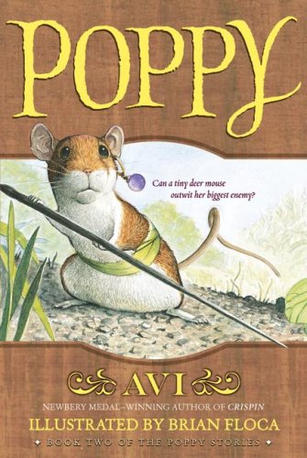
Poppy by Avi
Powerpoint by: Ana Lazardi

Slide 2
Plot Line
.
.
Climax: Poppy and Mr. Ocax battle.
Mr. Ocax dies.
.
Meets George and finds out owl is fake
.
.
Gets to New House
.
.
Ereth can now get salt
Meets Ereth
Lungwort and Poppy go to ask Mr. Ocax permission to move to New House. Mr Ocax says no.
Poppy announces news to
Her family and they move to
New House
Falling Action
.
Poppy decides to go to New House
.
.
Rising Action
.
Famiy runs out of food
Resolution
Poppy ecapes Mr. Ocax.
.
Poppy marries Rye, they have
11 children, and they dance
Under a nut tree
Exposition
Poppy and Ragweed go to Bannock Hill.
They get caught by Mr. Ocax and Ragweed dies.

Slide 3
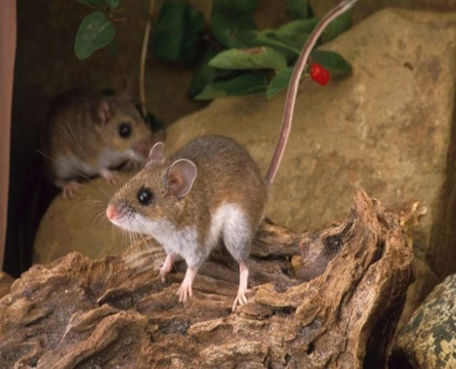
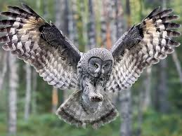
Some Main Characters
Poppy Poppy is a sweet little deer mouse that stands up for what she believes in and killed Mr. Ocax
Ragweed Ragweed is a careless and curios golden mouse. He was Poppy’s boyfriend but was killed by Mr. Ocax.
Mr. Ocax Mr. Ocax claimed that he was the ruler of Dimwood Forest and that he portected mice, but really he did the opposite. He was also afraid of a fake owl in New House.

Slide 4
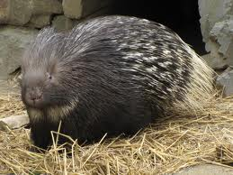
More Main Characters
Ereth Ereth was a vegetarian porcupine that wanted the slat lick very badly. He helped Poppy get to New House and Mr.Ocax is scared of him.
Lungwort Lungwort is Poppy’s father and he only believes in what HE says.

Slide 5
Theme
“stand up for what you believe in”
PROVE IT!
I think Poppy’s theme is to stand up for what you believe in because Poppy stood up to Mr. Ocax (her enemy) because she truly believed there was something suspicious in New House.

Slide 6
Conflicts and Resolutions
mice have to ask for permission to go to lots of places | Mr. Ocax dies
Poppy makes a deal to Ereth to give him salt from the salt lick | Mr. Ocax bumps into the salt lick, making it fall into chunks on the ground
family runs out of food and they can’t go to New House | Mr. Ocax dies

Slide 7
My Personal Reflection
I liked the book Poppy because it made me want to read more. Every time we stopped reading I would always have the urge to flip the page and read more. Also, it has a lot of interesting details that make you clearly see what’s happening in your mind. I don’t really know what would make the book better. I don’t think its perfect, but I don’t really know what it was lacking. I would recommend this book to someone who likes a thorough description of something or to someone who likes animals. ☺

Slide 8
Thanks for Watching!

